Slide 1
Network Layer – Part II
Computer Communications and Networks
ITCS 6166/8166
Dr. Dewan Tanvir Ahmed
Department of Computer Science
University of North Carolina at Charlotte

Slide 2
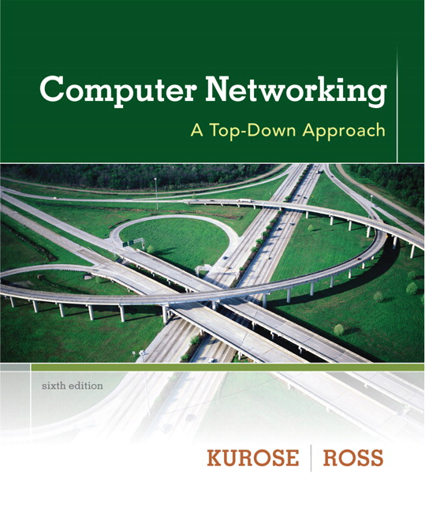

Chapter 4 Network Layer
Computer Networking: A Top Down Approach 6th edition Jim Kurose, Keith Ross Addison-Wesley March 2012
A note on the use of these ppt slides:
We’re making these slides freely available to all (faculty, students, readers). They’re in PowerPoint form so you see the animations; and can add, modify, and delete slides (including this one) and slide content to suit your needs. They obviously represent a lot of work on our part. In return for use, we only ask the following:
If you use these slides (e.g., in a class) that you mention their source (after all, we’d like people to use our book!)
If you post any slides on a www site, that you note that they are adapted from (or perhaps identical to) our slides, and note our copyright of this material.
Thanks and enjoy! JFK/KWR
All material copyright 1996-2012
J.F Kurose and K.W. Ross, All Rights Reserved

Slide 3
Chapter 4: outline
4.1 introduction
4.2 virtual circuit and datagram networks
4.3 what’s inside a router
4.4 IP: Internet Protocol
datagram format
IPv4 addressing
ICMP
IPv6
4.5 routing algorithms
link state
distance vector
hierarchical routing
4.6 routing in the Internet
RIP
OSPF
BGP
4.7 broadcast and multicast routing

Slide 4
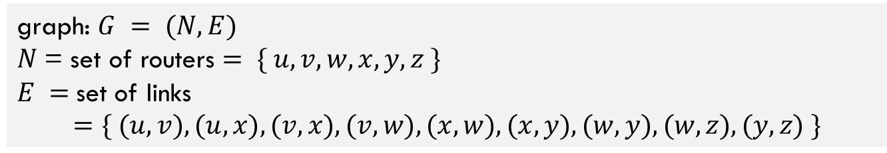
Graph abstraction
5
v
3
w
2
5
u
2
1
z
3
1
2
x
y
1
graph: $G = (N,E)$
$N$= set of routers $= \{ u, v, w, x, y, z \}$
$E =$set of links
$$=\{ (u,v), (u,x), (v,x), (v,w), (x,w), (x,y), (w,y), (w,z), (y,z) \}$$
aside: graph abstraction is useful in other network contexts, e.g.,
P2P, where N is set of peers and E is set of TCP connections

Slide 5
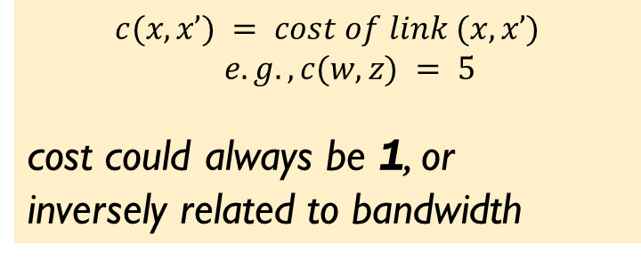
Graph abstraction: costs
5
$$c(x,x’) = cost of link (x,x’)$$
$$e.g., c(w,z) = 5$$
cost could always be 1, or
inversely related to bandwidth
v
3
w
2
5
u
2
1
z
3
1
2
x
y
1
cost of path $(x1, x2, x3,…, xp) = c(x1,x2) + c(x2,x3) + … + c(x_{p−1},xp)$
key question: what is the least-cost path between u and z?
routing algorithm: algorithm that finds that least cost path

Slide 6
Routing Algorithm Classification
Q: global or decentralized information?
Global:
all routers have complete topology and link cost info
Example: Link State (LS) algorithms
Decentralized:
router knows physically-connected neighbors and link costs to neighbors
iterative process of computation, and exchange of info with neighbors
“distance vector” algorithms
Q: static or dynamic?
Static:
routes change slowly over time
Dynamic:
routes change more quickly
periodic update
in response to link cost changes

Slide 7
Chapter 4: outline
4.1 introduction
4.2 virtual circuit and datagram networks
4.3 what’s inside a router
4.4 IP: Internet Protocol
datagram format
IPv4 addressing
ICMP
IPv6
4.5 routing algorithms
link state
distance vector
hierarchical routing
4.6 routing in the Internet
RIP
OSPF
BGP
4.7 broadcast and multicast routing

Slide 8
A Link-State Routing Algorithm
Dijkstra’s algorithm
Net topology and link cost known to all nodes
accomplished via “Link state broadcast”
all nodes have same info
Computes least cost paths from one node (‘source’) to all other nodes
gives forwarding table for that node
notation:
c(x,y): link cost from node x to y; = ∞ if not direct neighbors
D(v): current value of cost of path from source to dest. v
p(v): predecessor node along path from source to v
N': set of nodes whose least cost path definitively known

Slide 9
Dijsktra’s Algorithm
1 Initialization:
2 N' = {u}
3 for all nodes v
4 if v adjacent to u
5 then D(v) = c(u,v)
6 else D(v) = ∞
7
8 Loop
9 find w not in N' such that D(w) is a minimum
10 add w to N'
11 update D(v) for all v adjacent to w and not in N' :
12 D(v) = min( D(v), D(w) + c(w,v) )
13 /* new cost to v is either old cost to v or known
14 shortest path cost to w plus cost from w to v */
15 until all nodes in N'

Slide 10
Dijkstra’s algorithm: example
D(v)
p(v)
D(w)
p(w)
D(x)
p(x)
D(y)
p(y)
D(z)
p(z)
Step
N'
0
u
7,u
3,u
5,u
∞
∞
1
uw
6,w
5,u
11,w
∞
2
uwx
6,w
11,w
14,x
3
uwxv
10,v
14,x
4
uwxvy
12,y
5
uwxvyz
x
9
notes:
construct shortest path tree by tracing predecessor nodes
ties can exist (can be broken arbitrarily)
5
7
4
8
u
3
w
y
z
2
3
7
4
v

Slide 11
Dijkstra’s algorithm: another example
Step
0
1
2
3
4
5
N'
u
D(v),p(v)
D(w),p(w)
D(x),p(x)
D(y),p(y)
D(z),p(z)
5
v
3
w
2
5
u
2
1
z
3
1
2
x
y
1

Slide 12
Dijkstra’s algorithm: another example
Step
0
1
2
3
4
5
N'
u
ux
uxy
uxyv
uxyvw
uxyvwz
D(v),p(v)
2,u
2,u
2,u
D(w),p(w)
5,u
4,x
3,y
3,y
D(x),p(x)
1,u
D(y),p(y)
∞
2,x
D(z),p(z)
∞
∞
4,y
4,y
4,y
5
v
3
w
2
5
u
2
1
z
3
1
2
x
y
1

Slide 13
Dijkstra’s algorithm: example (2)
resulting shortest-path tree from u:
v
w
u
z
x
y
resulting forwarding table in u:
destination
link
v
(u,v)
x
(u,x)
y
(u,x)
w
(u,x)
z
(u,x)

Slide 14
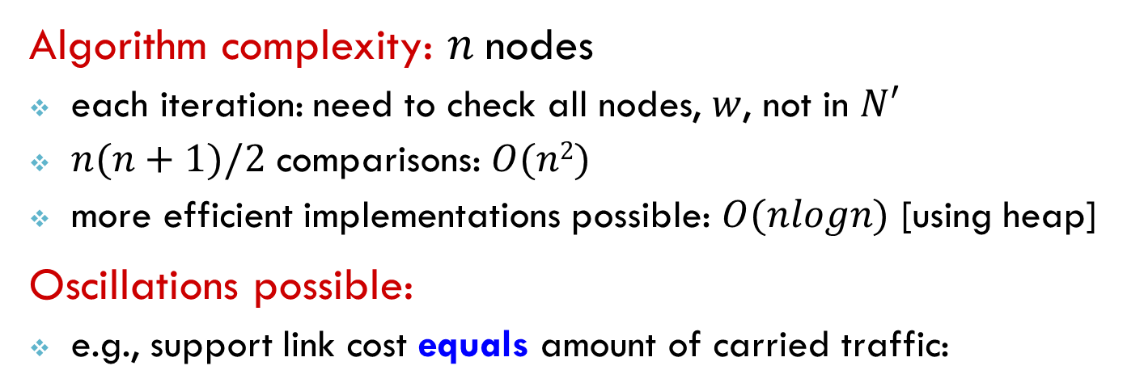
Dijkstra’s algorithm, discussion
Algorithm complexity: $n$nodes
each iteration: need to check all nodes, $w$, not in $N′$
$n(n+1)/2$ comparisons: $O(n2)$
more efficient implementations possible: $O(nlogn)$ [using heap]
Oscillations possible:
e.g., support link cost equals amount of carried traffic:
A
A
A
A
1
1+e
2+e
0
0
2+e
2+e
0
D
B
D
B
D
B
D
B
0
0
1+e
1
0
0
1+e
1
0
C
e
0
0
1
0
0
1
C
C
1+e
C
1
e
initially
given these costs,
find new routing….
resulting in new costs
given these costs,
find new routing….
resulting in new costs
given these costs,
find new routing….
resulting in new costs

Slide 15
Dijkstra’s algorithm, discussion
Solution to Oscillations:
One solution
mandate that link costs not depend on the amount of traffic carried— an unacceptable solution since one goal of routing is to avoid highly congested (for example, high-delay) links.
Second solution
not all routers run the LS algorithm at the same time.

Slide 16
Chapter 4: outline
4.1 introduction
4.2 virtual circuit and datagram networks
4.3 what’s inside a router
4.4 IP: Internet Protocol
datagram format
IPv4 addressing
ICMP
IPv6
4.5 routing algorithms
link state
distance vector
hierarchical routing
4.6 routing in the Internet
RIP
OSPF
BGP
4.7 broadcast and multicast routing

Slide 17
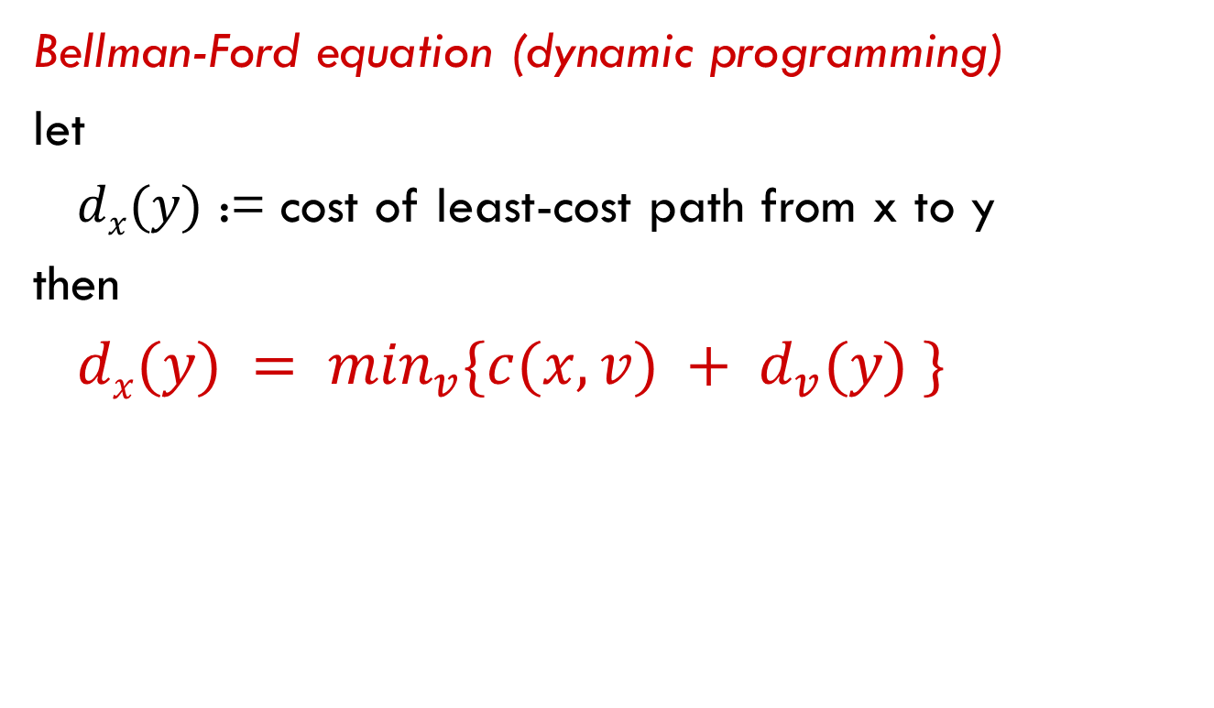
Distance vector algorithm
Bellman-Ford equation (dynamic programming)
let
$dx(y)$ := cost of least-cost path from x to y
then
$dx(y) = \min_{v}⁡\{c(x,v) + d_{v}(y) \}$
cost from neighbor v to destination y
cost to neighbor v
min taken over all neighbors v of x

Slide 18
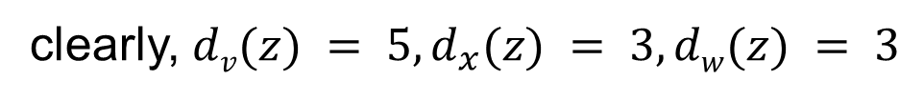
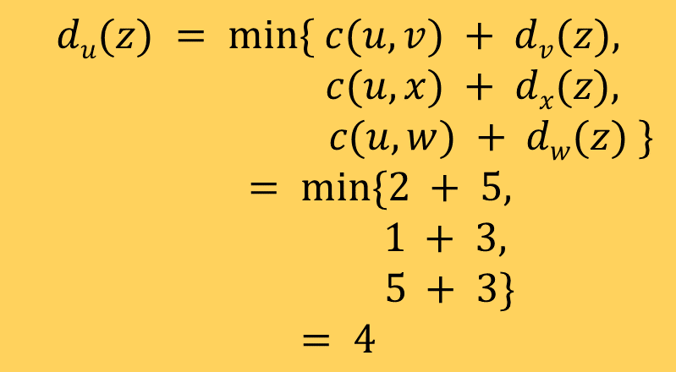
Bellman-Ford example
5
clearly, $dv(z) = 5, d_{x}(z) = 3, dw(z) = 3$
v
3
w
2
5
u
z
B-F equation says:
2
1
3
1
$$du(z) = min⁡\{ c(u,v) + dv(z),$$
$$c(u,x) + dx(z),$$
$$c(u,w) + dw(z) \}$$
$$= min⁡\{2 + 5,$$
$$1 + 3,$$
$$5 + 3\}$$
$$= 4$$
x
y
2
1
node achieving minimum is next hop in shortest path, used in forwarding table

Slide 19
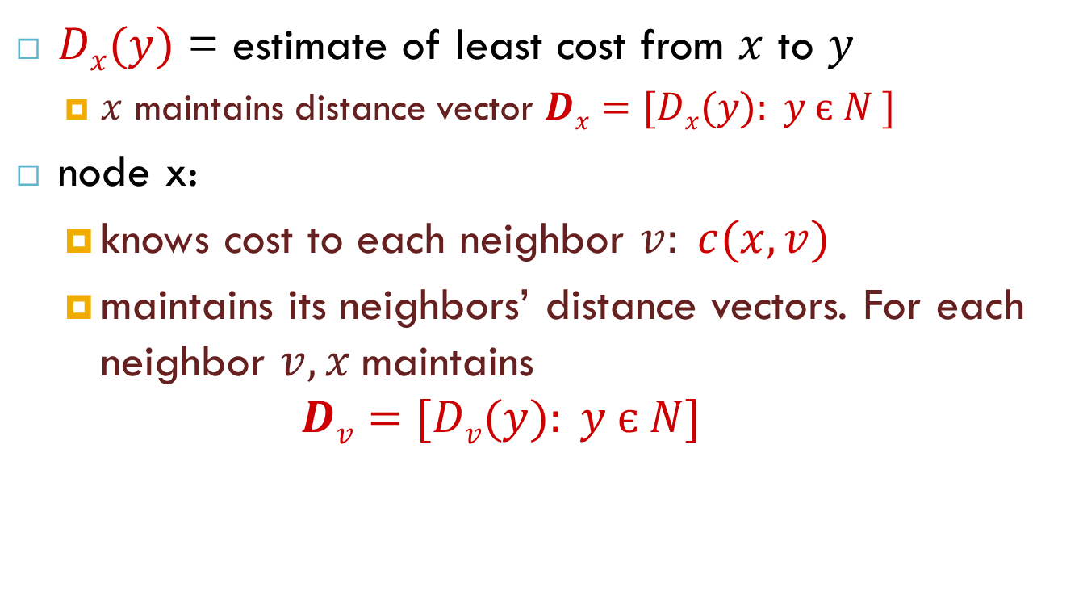
Distance vector algorithm
$Dx(y)$ = estimate of least cost from $x$ to $y$
$x$ maintains distance vector $Dx=[Dx(y): y є N ]$
node x:
knows cost to each neighbor $v: c(x,v)$
maintains its neighbors’ distance vectors. For each neighbor $v, x$maintains $Dv=[Dv(y): y є N]$

Slide 20
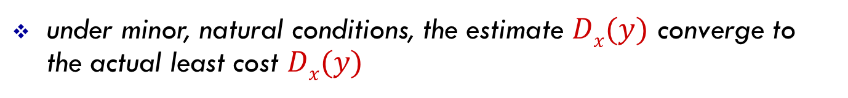
Distance vector algorithm
key idea:
from time-to-time, each node sends its own distance vector estimate to neighbors
when x receives new DV estimate from neighbor, it updates its own DV using B-F equation:
$$Dx(y) ← minv\{c(x,v) + Dv(y)\} for each node y ∊ N$$
under minor, natural conditions, the estimate $Dx(y)$ converge to the actual least cost $Dx(y)$

Slide 21
Distance vector algorithm
Iterative and Asynchronous:
each local iteration caused by:
local link cost change
DV update message from neighbor
Distributed:
each node notifies neighbors only when its DV changes
neighbors then notify their neighbors if necessary
each node:
wait for (change in local link cost or msg from neighbor)
recompute estimates
if DV to any dest has changed, notify neighbors

Slide 22
D_{x}(y) = min{c(x,y) + D_{y}(y), c(x,z) + D_{z}(y)} = min{2+0 , 7+1} = 2
D_{x}(z) = min{c(x,y) + D_{y}(z), c(x,z) + D_{z}(z)}
= min{2+1 , 7+0} = 3
node x
table
cost to
cost to
x y z
x y z
x
0 2 7
x
0
2
3
y
y
2 0 1
from
∞
∞
∞
from
z
∞
∞
∞
z
7 1 0
node y
table
cost to
x y z
y
2
1
x
∞
∞
z
∞
2 0 1
x
from
y
7
z
∞
∞
∞
node z
table
cost to
x y z
x
∞ ∞ ∞
from
y
∞
∞
∞
z
7
1
0
time

Slide 23
node x
table
cost to
cost to
cost to
x y z
x y z
x y z
x
0 2 7
x
0
2
3
x
0 2 3
y
y
2 0 1
from
∞
∞
∞
from
y
2 0 1
z
z
from
∞
∞
∞
7 1 0
z
3 1 0
node y
table
cost to
cost to
cost to
x y z
x y z
x y z
y
2
1
x
∞
∞
x
0 2 7
∞
2 0 1
x
0 2 3
x
z
from
y
y
2 0 1
y
2 0 1
7
from
from
z
∞
∞
∞
z
7 1 0
z
3 1 0
node z
table
cost to
cost to
cost to
x y z
x y z
x y z
x
∞ ∞ ∞
x
0 2 7
x
0 2 3
y
y
2 0 1
from
y
∞
∞
from
2 0 1
from
∞
z
z
3 1 0
z
3 1 0
7
1
0
time
time

Slide 24
Distance vector: link cost changes
link cost changes:
node detects local link cost change
updates routing info, recalculates distance vector
if DV changes, notify neighbors
1
y
4
1
x
z
50
t₀ : y detects link-cost change, updates its DV, informs its neighbors.
Good news
Travels fast
t₁ : z receives update from y, updates its table, computes new least cost to x , sends its neighbors its DV.
t₂ : y receives z’s update, updates its distance table. y’s least costs do not change, so y does not send a message to z.

Slide 25
Distance vector: link cost changes
60
link cost changes:
node detects local link cost change
bad news travels slow - “count to infinity” problem!
44 iterations before algorithm stabilizes: see text
y
4
1
x
z
50
At t_{0:}

Slide 26
Distance vector: link cost changes
60
y
4
1
x
z
50
At t1:
Node y informs z of its new distance vector
Now there is a routing loop —in order to get to x
y routes through z, and z routes through y.
After t_{1:}
D_{z}(x) = min{50 + 0,1 + 6} = 7.
At t2:
Node z informs y of its new distance vector

Slide 27
Distance vector: link cost changes
60
y
4
1
x
z
50
After t2:
In a similar manner, after receiving z’s new distance vector, y determines Dy(x) = 8 and sends z its distance vector. z then determines Dz(x) = 9 and sends y its distance vector, and so on.
poisoned reverse:
If Z routes through Y to get to X :
Z tells Y its (Z’s) distance to X is infinite (so Y won’t route to X via Z)

Slide 28
Chapter 4: outline
4.1 introduction
4.2 virtual circuit and datagram networks
4.3 what’s inside a router
4.4 IP: Internet Protocol
datagram format
IPv4 addressing
ICMP
IPv6
4.5 routing algorithms
link state
distance vector
hierarchical routing
4.6 routing in the Internet
RIP
OSPF
BGP
4.7 broadcast and multicast routing

Slide 29
Hierarchical routing
Administrative autonomy
internet = network of networks
each network admin may want to control routing in its own network
Aggregate routers into regions, “autonomous systems” (AS)
routers in same AS run same routing protocol (intra-AS - routing protocol)
routers in different AS can run different intra-AS routing protocol
gateway router:
at “edge” of its own AS has link to router in another AS

Slide 30
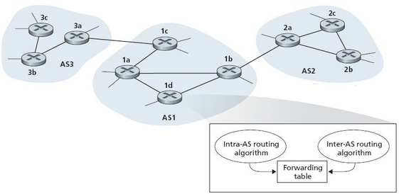
Interconnected ASes
forwarding table configured by both intra- and inter-AS routing algorithm
intra-AS sets entries for internal dests
inter-AS & intra-AS sets entries for external dests

Slide 31
Example: setting forwarding table in router 1d
Suppose AS1 learns (via inter-AS protocol) that subnet x reachable via AS3 (gateway 1c), but not via AS2
Router 1d determines from intra-AS routing info that its interface I is on the least cost path to 1c
installs forwarding table entry (x,I)
…
x
3c
3a
3b
AS3
2c
other
networks
1c
2a
other
networks
1a
2b
1b
AS2
AS1
1d

Slide 32
Example: choosing among multiple ASes
now suppose AS1 learns from inter-AS protocol that subnet x is reachable from AS3 and from AS2.
to configure forwarding table, router 1d must determine which gateway it should forward packets towards for dest x
…
x
3c
……
3a
3b
AS3
2c
other
networks
1c
2a
other
networks
1a
2b
1b
AS2
AS1
1d
?

Slide 33
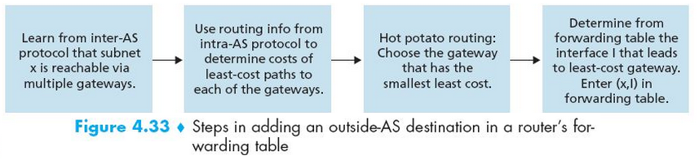
Example: choosing among multiple ASes
hot potato routing: send packet towards closest of two routers.

Slide 34
Chapter 4: outline
4.1 introduction
4.2 virtual circuit and datagram networks
4.3 what’s inside a router
4.4 IP: Internet Protocol
datagram format
IPv4 addressing
ICMP
IPv6
4.5 routing algorithms
link state
distance vector
hierarchical routing
4.6 routing in the Internet
RIP
OSPF
BGP
4.7 broadcast and multicast routing

Slide 35
Intra-AS Routing
Aka, interior gateway protocols (IGP)
most common intra-AS routing protocols:
RIP: Routing Information Protocol
OSPF: Open Shortest Path First
IGRP: Interior Gateway Routing Protocol (Cisco proprietary)

Slide 36
RIP - Routing Information Protocol
Distance vector algorithm
distance metric: # hops (max = 15 hops), each link has cost 1
DVs exchanged with neighbors every 30 sec (aka advertisement)
each advertisement: list of up to 25 destination subnets (in IP addressing sense)
from router A to destination subnets:
u
v
subnet hops
u 1
v 2
w 2
x 3
y 3
z 2
A
B
w
x
z
C
D
y

Slide 37
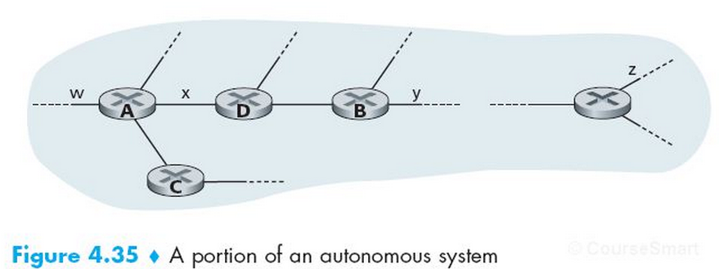
RIP: example
routing table in router D
destination subnet next router # hops to dest
w A 2
y B 2
z B 7
x -- 1
…. …. ....

Slide 38
RIP: example
A-to-D advertisement
dest next hops
w - 1
x - 1
z C 4
…. … ...
Routing table in router D
destination subnet next router # hops to dest
w A 2
y B 2
z B 7
x -- 1
…. …. ....
A
5

Slide 39
RIP: link failure and recovery
If no advertisement heard after 180 sec
=> neighbor/link declared dead
routes via neighbor invalidated
new advertisements sent to neighbors
neighbors in turn send out new advertisements (if tables changed)
poison reverse used to prevent ping-pong loops (infinite distance = 16 hops)

Slide 40
OSPF (Open Shortest Path First)
It uses link state algorithm
LS packet dissemination
Topology map at each node
Route computation using Dijkstra’s algorithm
Advertisements flooded to entire AS
carried in OSPF messages directly over IP (rather than TCP or UDP)
IS-IS (Intermediate System to Intermediate System) routing protocol: nearly identical to OSPF

Slide 41
OSPF “advanced” features (not in RIP)
Security: all OSPF messages authenticated (to prevent malicious intrusion)
Multiple same-cost paths allowed (only one path in RIP)
For each link, multiple cost metrics for different Type of Service (TOS)
satellite link cost set “low” for best effort ToS;
high for real time ToS
Hierarchical OSPF in large domains.

Slide 42
Hierarchical OSPF
boundary router
backbone router
backbone
area
border
routers
area 3
internal
routers
area 1
area 2

Slide 43
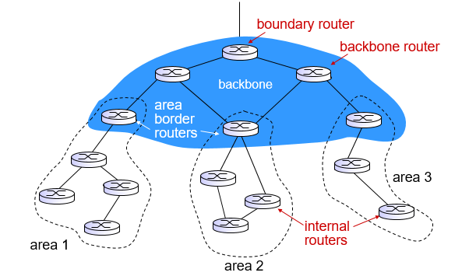
Hierarchical OSPF
two-level hierarchy: local area, backbone.
link-state advertisements only in area
each nodes has detailed area topology; only know direction (shortest path) to nets in other areas.
area border routers: “summarize” distances to nets in own area, advertise to other Area Border routers.
backbone routers: run OSPF routing limited to backbone.
boundary routers: connect to other AS’s.

Slide 44
Internet inter-AS routing: BGP
BGP (Border Gateway Protocol): the de facto inter-domain routing protocol
“glue that holds the Internet together”
BGP provides each AS a means to:
eBGP: obtain subnet reachability information from neighboring ASs.
iBGP: propagate reachability information to all AS-internal routers.
determine “good” routes to other networks based on reachability information and policy.

Slide 45
BGP basics
BGP session: two BGP routers (“peers”) exchange BGP messages:
advertising paths to different destination network prefixes
exchanged over TCP connections
3c
3a
BGP
message
3b
AS3
2c
other
networks
1c
2a
other
networks
1a
2b
1b
AS2
AS1
1d

Slide 46
BGP basics: distributing path information
using eBGP session between 3a and 1c, AS3 sends prefix reachability info to AS1.
1c can then use iBGP do distribute new prefix info to all routers in AS1
1b can then re-advertise new reachability info to AS2 over 1b-to-2a eBGP session
when router learns of new prefix, it creates entry for prefix in its forwarding table.
eBGP session
3a
3b
iBGP session
AS3
2c
other
networks
1c
2a
other
networks
1a
2b
1b
AS2
AS1
1d

Slide 47
Path attributes and BGP routes
advertised prefix includes BGP attributes
prefix + attributes = “route”
two important attributes:
AS-PATH: contains ASs through which prefix advertisement has passed: e.g., AS 67, AS 17
NEXT-HOP: indicates specific internal-AS router to next-hop AS. (may be multiple links from current AS to next-hop-AS)
gateway router receiving route advertisement uses import policy to accept/decline
e.g., never route through AS x
policy-based routing

Slide 48
BGP route selection
router may learn about more than 1 route to destination AS, selects route based on:
local preference value attribute: policy decision
shortest AS-PATH
closest NEXT-HOP router: hot potato routing
additional criteria

Slide 49
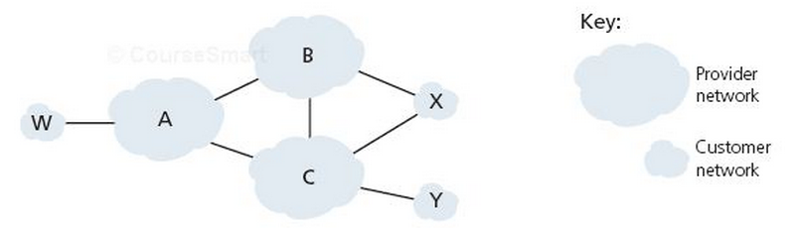
BGP routing policy
A,B,C are provider networks
X,W,Y are customers (of provider networks)
X is dual-homed: attached to two networks
X does not want to route from B via X to C
.. so X will not advertise to B a route to C

Slide 50
BGP routing policy (2)
A advertises path AW to B
B advertises path BAW to X
Should B advertise path BAW to C?
No way! B gets no “revenue” for routing CBAW since neither W nor C are B’s customers
B wants to force C to route to w via A
B wants to route only to/from its customers!

Slide 51
Why different Intra-, Inter-AS routing ?
policy:
inter-AS: admin wants control over how its traffic routed, who routes through its net.
intra-AS: single admin, so no policy decisions needed
scale:
hierarchical routing saves table size, reduced update traffic
performance:
intra-AS: can focus on performance
inter-AS: policy may dominate over performance

Slide 52
Thank you!

